Slide 1





Book Reader
Justin Starks
Austin Starks
Mimi
Shih
Jiaxin
Du
Sabina
Chang

Slide 2
Introduction

Slide 3
Agenda
BookReader Overview
Video Demo
Review design decision changes
Discuss design patterns that we used
Show implementation of important functionalities
Lessons learned

Slide 4
Main Functionalities
Search for books
Add/move books among bookshelves
Recommend books
Update reading progress
Add rating
Add book review
Library management
Tracking book progress
BookReader
Interacting with friends
Profile management
Add friends
Comment/Like posts on public timeline
Display top books
Add personal description
Adjust privacy setting
Notes:
Our application, the BookReader, has four main functionalities: Library management, tracking book progress, interacting with friends and profile management. The first three ones are predefined and we will not go into great details here. We would like to highlight our team functionality: profile management.
For this functionality, users can display their top favorite books that best represent them. They can also write a personal description to let others know about them. Finally, users can adjust privacy setting which will decide who can have access to view the content on their profile.
Maintainability > Usability > Extensibility
Layered Pattern Model-View-Controller to efficiently model the behavior of our system
Client-Server Pattern to allow the communication between the server and multiple clients
While we are developing the Bookreader, we chooses

Slide 5
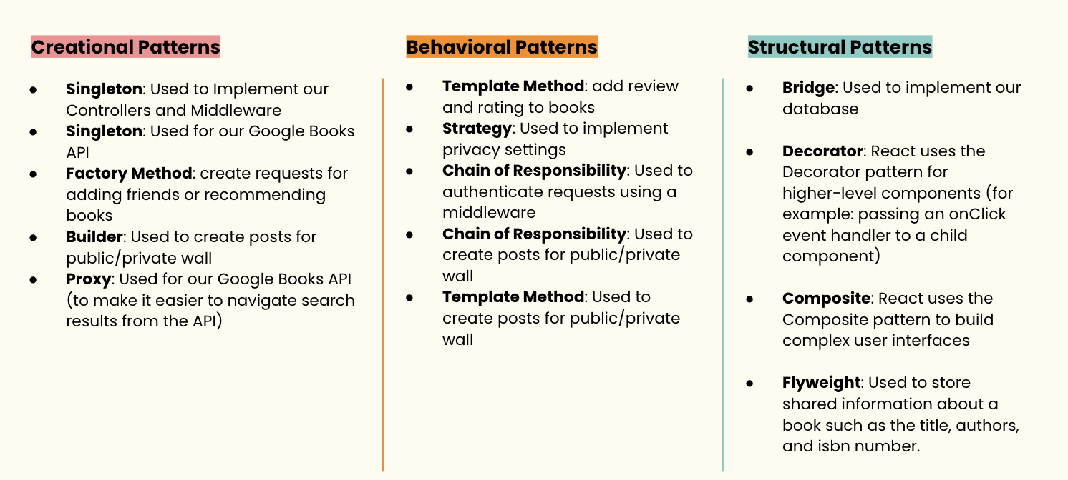
Maintainability and Extensibility motivate our design decisions. Usability influences UI design
System level: MVC + Client-Server Architecture pattern
Object level: 11 design patterns in 14 places
Client
Server
Views
(Search, Library, Profile, Public wall, Private wall, Friendship, etc.)
Controllers
(Search, Library, User, wall, Friendship, etc.)
Request
Response
Models
(Book, Bookshelf, User, Post, Friendship, etc)
Notes:
During the early stage of implementation, we decide to keep the system maintainable and extensible. To satisfy these quality attributes we adopted some design decision. On the system level, we adopted MVC and Client-Server for our Architecture pattern. We are able to encapsulate related business logic into appropriate components and reduce their dependency. On the object level, we used 11 design patterns in 14 different places. Using design patterns help our code to follow with SOLID principle and OO best practices. We will talk more about the design pattern later. Overall, these design decision ensure that our system remains maintainable and extensible throughout the development.
In addition to the internal quality attributes, we work hard to ensure that the BookReader has good usability. We provide clean and intuitive UI in our final solution. We will now display a video to show how we satisfy the usability quality attributes.

Slide 6
Demo Video

Slide 7
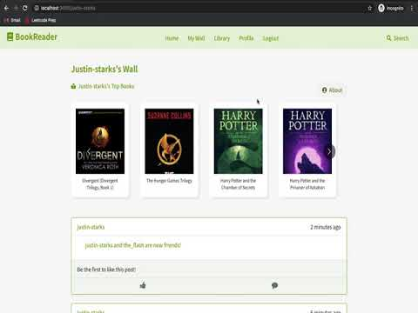

Slide 8
Design Patterns

Slide 9
Design Patterns: What We Changed
Presentation 1:
Singleton: Used to Implement our Controllers
Singleton: Used for our Google Books API
Factory Method: Used to build post for our public/private wall
Builder: Creating new books in our database if they don’t exist, and make it easier to add user ratings/reviews
Updated
Updated
Notes:
Now we move on to review design decision changes. In our initial presentation, we proposed four possible scenarios for 3 creational pattern. The first two singleton use cases for controllers and google books API remain the same. But we decide to change how we build posts for public/private wall, and how we create new book

Slide 10
Change: Posts for public/private wall
Add to bookshelf
Post Handler
Create post for each event
Bookshelf Builder
Update reading progress
Progress Builder
Solution:
Factory method becomes:
- Chain of Responsibility
- Builder
- Template
Form a friendship
Friendship Builder
Rate a book
Rate Book Builder
Add a book review
Review Book Builder
Notes:
We realize that making a post to the public and private wall requires more efforts. There are several events that would trigger the system to create a post, including when user adds a book to the bookshelf, updates reading progress, forms a friendship, rates a book or makes a book review. Each of these events have separate api handlers.
We would like to encapsulate post creation logic in one place and also integrate the creation process with each api handlers. Moreover, the post created for each of the event would varies in the content but shares some common preparation steps. So in the end we use three patterns to implement a solution. Austin will talk more about this in details later

Slide 11
Change: Add new books into db
Flyweight: 1
Owner: ‘John’
Rating: ‘like’
Review: ‘Great’
Progress: 46
Flyweight: 1
Owner: ‘Tim’
Rating: ‘like’
Review: ‘Good read!’
Progress: 50
Title: Harry Potter
Author: JK Rowling
Isbn: 232759013
Owner: ‘Tim’
Rating: ‘like’
Review: ‘Good read!’
Progress: 50
Title: Harry Potter
Author: JK Rowling
Isbn: 232759013
Owner: ‘John’
Rating: ‘like’
Review: ‘Great’
Progress: 46
Id: 1
Title: Harry Potter
Author: JK Rowling
Like: 4
Dislike: 0
PageCount: 500
Isbn: 232759013
Title: Harry Potter
Author: JK Rowling
Isbn: 232759013
Owner: ‘Helen’
Rating: ‘like’
Review: ‘Love it’
Progress: 22
Title: Harry Potter
Author: JK Rowling
Isbn: 232759013
Owner: ‘Amy’
Rating: ‘like’
Review: ‘Excellent’
Progress: 34
Flyweight: 1
Owner: ‘Helen’
Rating: ‘like’
Review: ‘Love it’
Progress: 22
Flyweight: 1
Owner: ‘Amy’
Rating: ‘like’
Review: ‘Excellent’
Progress: 34
Solution: Builder becomes Flyweight
Notes:
We also change how we add new books to our db. The original builder pattern would make it easy to add info step by step to a book object. But if a particular book is very popular among users, our db will have many repeated information of that book, like title, thumbnail, authors, ISBN. Yet these information never actually changes from user to user. Moreover, when we want to compile the overall users rating of a book, we need to first get that book from every user who has it then sum up the rating. So we decide to change our approach
We leverage flyweight pattern when we want to store a new book. We extract shared information into flyweight and store individual reading progress, rating and review separately. This helps us reduce the amount of repeated data and make calculating overall like and dislike very easy.

Slide 12
Design Patterns: All the patterns we used
Creational Patterns
Behavioral Patterns
Structural Patterns
Singleton: Used to Implement our Controllers and Middleware
Singleton: Used for our Google Books API
Factory Method: create requests for adding friends or recommending books
Builder: Used to create posts for public/private wall
Template Method: add review and rating to books
Strategy: Used to implement privacy settings
Chain of Responsibility: Used to authenticate requests using a middleware
Chain of Responsibility: Used to create posts for public/private wall
Template Method: Used to create posts for public/private wall
Bridge: Used to implement our database
Decorator: React uses the Decorator pattern for higher-level components (for example: passing an onClick event handler to a child component)
Composite: React uses the Composite pattern to build complex user interfaces
Flyweight: Used to store shared information about a book such as the title, authors, and isbn number.
Proxy: Used for our Google Books API (to make it easier to navigate search results from the API)
Notes:
We have 14 instances of design patterns, where singleton, CoR and template method patterns are all used twice to implement separate functionalities. Our project uses a combination of creational, behavioral, and structural patterns to implement many of the functionalities present in the demo video.. For instance, we utilize the proxy pattern for our Google Books API, and the Bridge pattern to separate the abstraction of a database from its implementing
However, what makes the architecture of our system so unique is that we combine 3 different design patterns to create one functionality

Slide 13
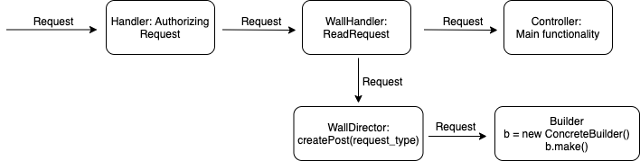
Three Design Patterns to implement posting to wall?
Chain of Responsibility
Builder
Template Method
Notes:
We used 3 different design patterns to implement the functionality of making a post on the public and private walls. Each request that would make a post on the wall had a request_type parameter in the body. The Chain of Responsibility would look for requests on a route that had specifically registered request_types, and if it saw one, it would trigger an event that would begin to make a post. To make one, you would create a concrete builder class that is a subclass of the abstract builder.

Slide 14
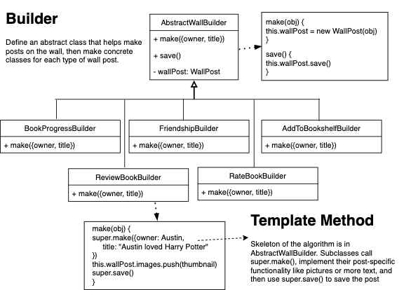
These Design Patterns made it EASY to make a post on the wall in a way that is highly maintainable and extensible
Notes:
The abstract builder defines the beginning and end steps of the algorithm: starting with the make() function which makes a post on the wall. The concrete builders can also have additional logic for creating a post. For example, it can include texts on the wall or a picture of a book. After creating the post, the concrete class saves the post to the database by calling super.save().
Super.make() and super.save() defines the template method design pattern; the abstract builder only implements part of the algorithm, and the subclasses implement the rest of the logic of the algorithm.

Slide 15
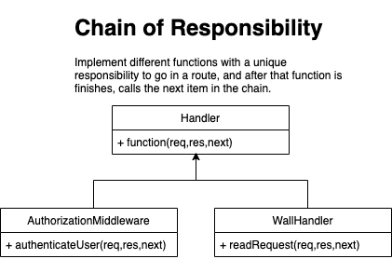
These Design Patterns made it EASY to make a post on the wall in a way that is highly maintainable and extensible
Notes:
Combining the template method, builder pattern, and chain of responsibility made it easy to create a system that would elegantly add posts to the walls.
It might sound complicated and like “too much” to use these 3 design patterns to implement a single functionality. On the contrary, these design patterns actually made it easier to add posts to the wall, and to drastically decrease coupling in the system. For example: the person in charge of implementing the “add to friends” functionality did not need to concern themselves with how adding a user as friend would make a post on the timeline. They could just worry about implementing their own functionality in the controller. And then, the person implementing the “Post to Wall” functionality can easily go back, and add the wallHandler as a middleware between the authentication middleware, and the controller.
These design patterns help us obey the SOLID principle. By being able to separate our functionality of creating a post and the actual action the user took, we follow the single-responsibility principle. Additionally, by extending the abstract builder class, we follow the open-closed principle, because we do not have to modify our abstract builder class,

Slide 16
These Design Patterns made it EASY to make a post on the wall in a way that is highly maintainable and extensible
Lowered Coupling Increased Cohesion
Notes:
So in total, these 3 design patterns made the complex feature of creating a post on the wall into an extendable functionality with separation of concerns. These patterns allowed us to satisfy our quality attributes of maintainability and extensibility because it is easy to make new builders for other types us posts. It allowed us to lower coupling by having a specific module responsible for creating posts on the wall (as opposed to coupling the functionality in a controller). It also allowed us to increase cohesion, by grouping other concrete builders together.

Slide 17
Implementation Details of Important Functionalities

Slide 18
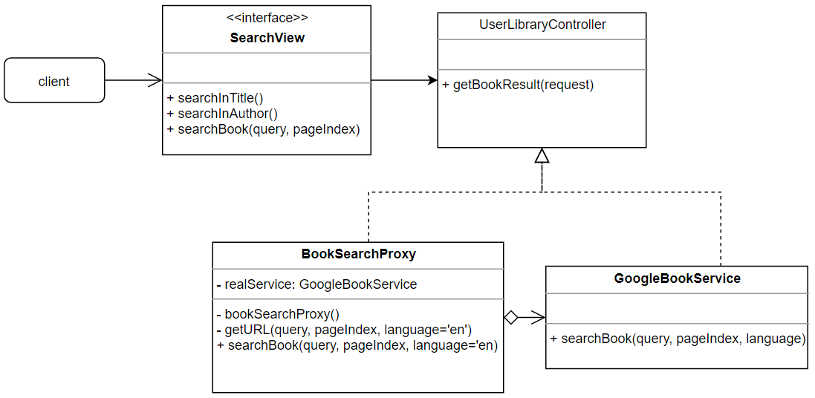
Search Book
Notes:
Now, Lets move to our implementation details. The first feature I am going to talk about is search book. We use Proxy and Singleton to build our search functionality. We have a interface which allow user to search book by title, by author or no restriction. SearchView interface will use RESTful api to connect with user library controller. In user library controller, we will implement booksearchproxy to search the book with parameter: search query and page index. Our book search proxy will execute google search book service to get the searched book result back.

Slide 19
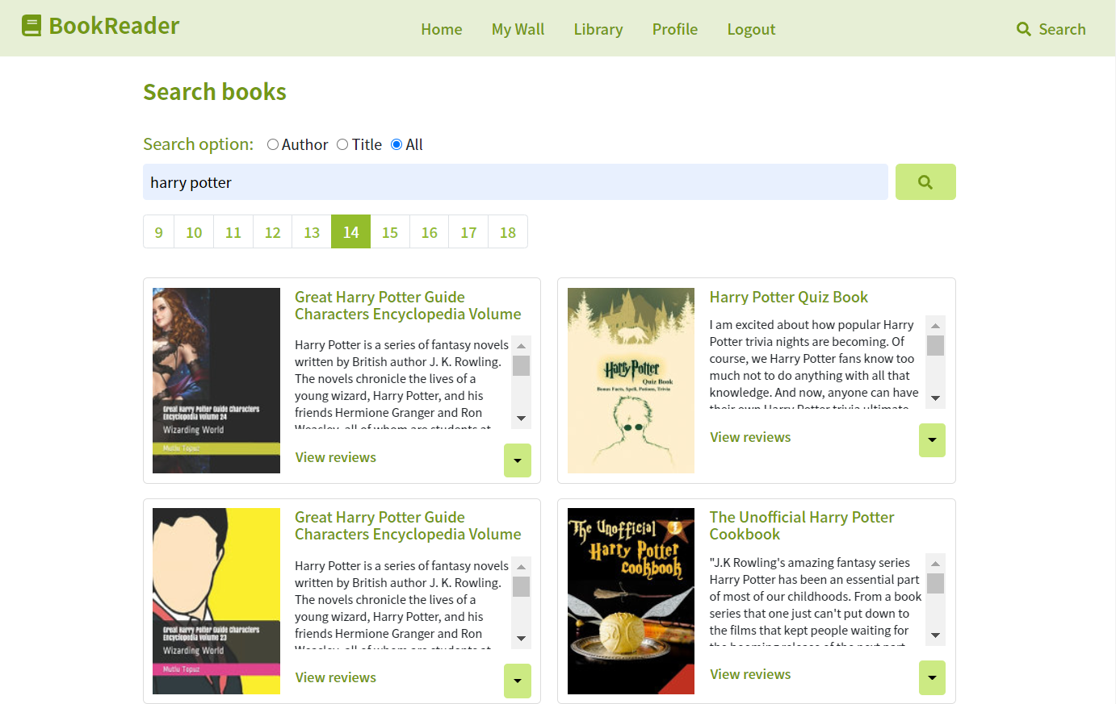
Search Book
Notes:
Here is a quick reminder about our search book UI. We have pagination, search options and the books result get from our proxy

Slide 20
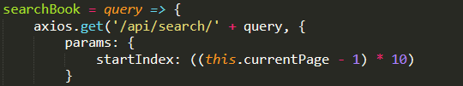
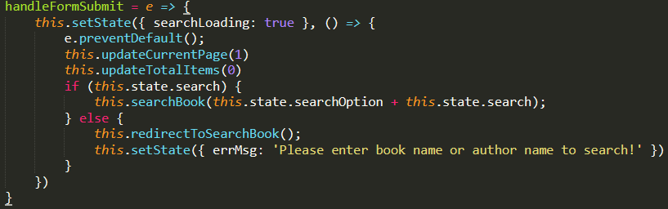
Search Book
Frontend
searchView.js
Notes:
Lets move to our code detail. This is our searchView file. When the client want to search books, it will input the search query and chosen search option such as searching the words only in title to searchBook function. searchBook function will have a GET request to backend to get the results that we want. The startIndex in parameter is used for getting book results on different page.

Slide 21
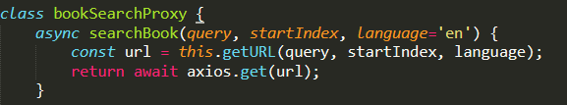
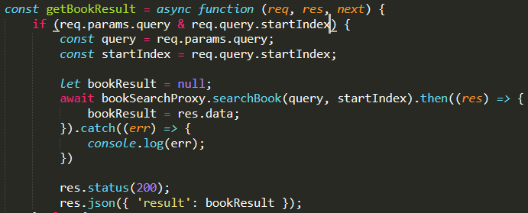
Search Book
Backend
userLibraryController.js
Notes:
Then, this is our backend controller and proxy. Booksearch proxy is open closed, so in the future, if we want to also search with different third party such as amazon book, we can easily add proxy to execute that.

Slide 22
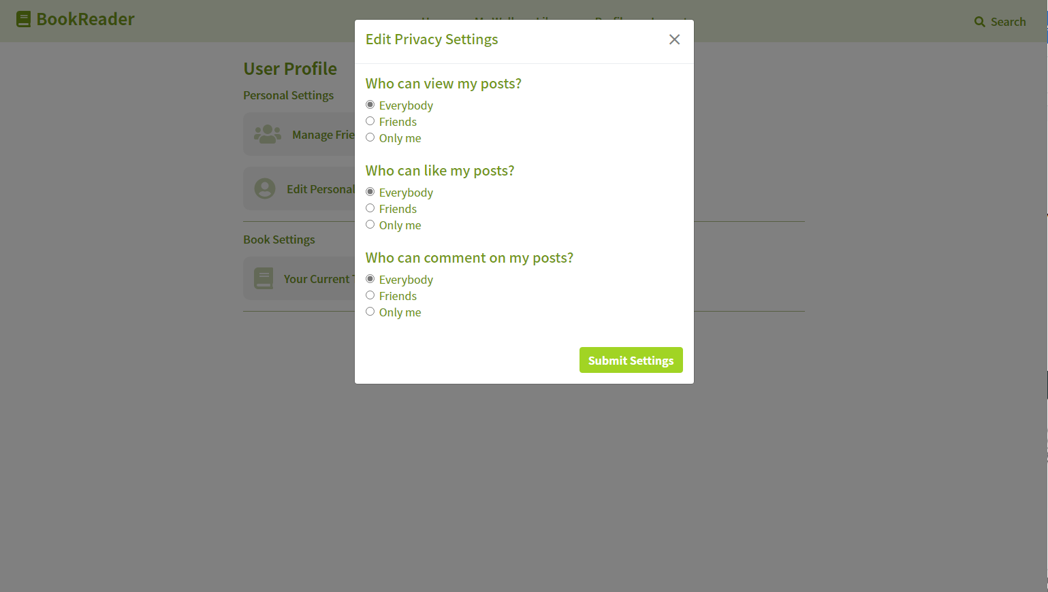
Fourth Functionality – Privacy settings
Notes:
Next, I’m going to introduce our fourth functionality. Based on the demo, we’ve seen that users can edit their privacy settings based on their preferences. Here’s the page that the user can change their settings. We can see that there are three criterias in this pop up screen which are who can view my posts, who can like my posts, and who can comment on my posts.

Slide 23
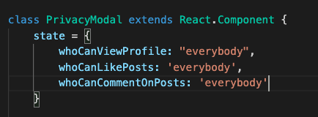
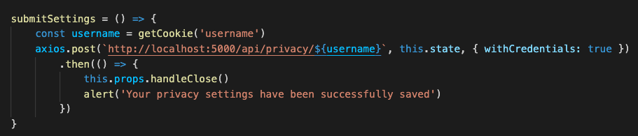
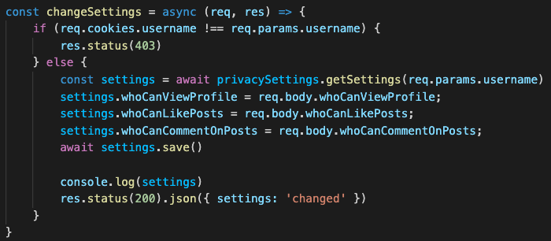
Update Privacy Settings
Frontend
privacyModal.js
Backend
privacyController.js
Notes:
First of all, in the frontend, privacyModal, the user is able to post their settings through fetching the restful api. In the backend, the privacy controller will support changes in the settings based on the user selection and saved it to the database.

Slide 24
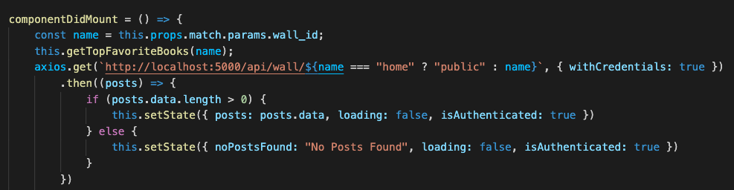
2. Access private walls
Privacy Settings
Frontend
./wall/index.js
Notes:
While coming into the walls, which can be both private and public, the frontend will decide to display either private wall or public wall based on the wall ID coming in. The frontend will then fetch a get request to the wall by target username. If the user successfully see the private wall, then the user is identified as authenticated.

Slide 25
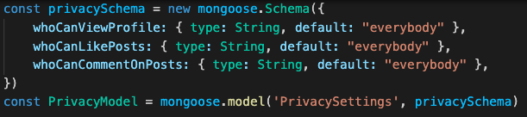
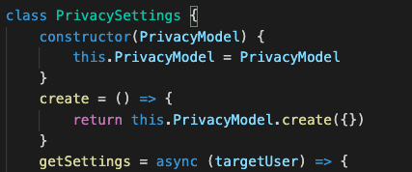
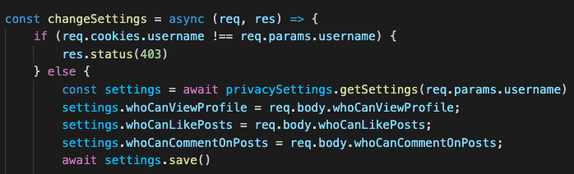
2. Access private walls (Cont.)
Privacy Settings
Backend
privacyModel
Verify privacy types with target user and current logged in user
privacySettings.js
privacyController.js
Notes:
To implement the privacy setting, first we have privacyModel to organize the information on who can view the profile, who can like the post, and who can comment on the posts.
The next level of the privacy settings will include functions such as create original privacy settings, verify the privacy type with login and target user, and get current user privacy settings.
Then we have a privacy controller over what we have discussed. Without directly calling the functions in the privacySettings, we have this controller to control over -> one “change settings” on the user privacy, and second “get current Settings For the input PrivacyType”

Slide 26
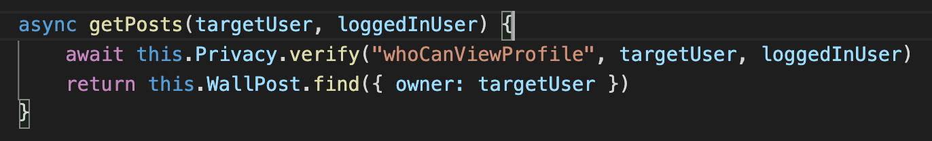
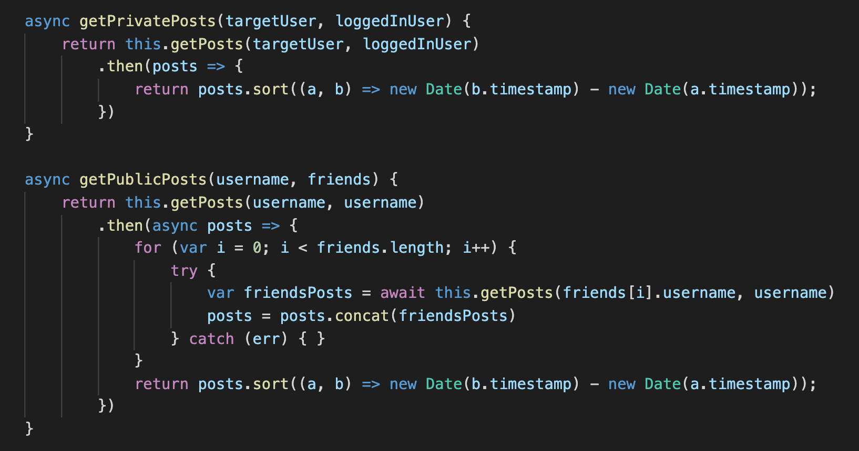
2. Access private walls (Cont.)
Posting on Walls
Backend
wallPosts.js
Notes:
After we discussed the privacy settings, we can go back to the implementation on the walls. We have to include the privacy settings into wallPost.js because for every implementation in the wall post, we need to verify the user with privacy type.
For example, when the user requests to get all the private posts to display on the private wall, the wallPost.js will call to verify who can view the post through privacy settings. The code snippet in the first screenshot is the one that actually implements the verify function from privacy settings.
For the second screentshot, we can see that there are two functions, one for the getPrivatePosts, and the other for the getPublicPosts. For both functions, we utilize the getPost method to verify the targetUser with logged-in user. For the get public post, it will retrieve all of your friends and verify the settings between you and your friend.

Slide 27
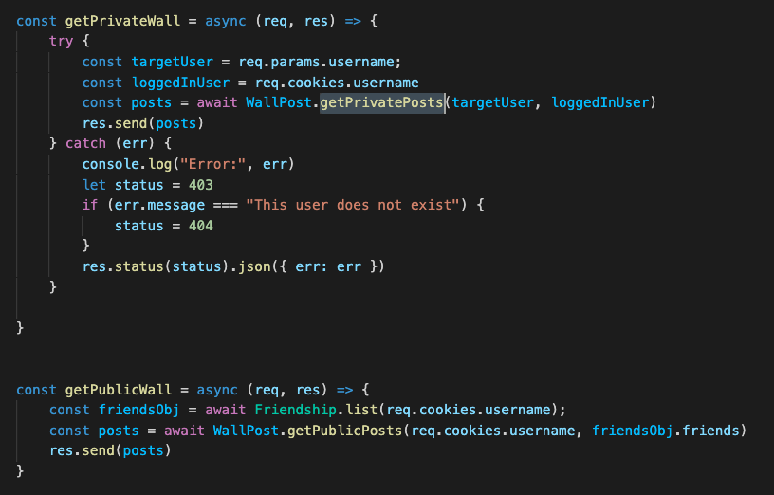
2. Access private walls (Cont.)
Posting on Walls
Backend
wallController.js
Notes:
In the end, on the wallController, we can call wallPost.getPrivatePosts() and wallPost.getPublicPosts(). The client doesn't know that the wallPosts internally has a privacy settings class, that only gets the posts if it satisfies the privacy settings. We’re able to hide the implementation details on privacy settings within walls. For other actions on the wall are also implemented through similar ways of calling through the wallPost. For example the function for toggle likes on the post, and functions for add/delete comments on the wall.
This concludes our forth functionality privacy settings and how it affects the implementation of our walls.

Slide 28
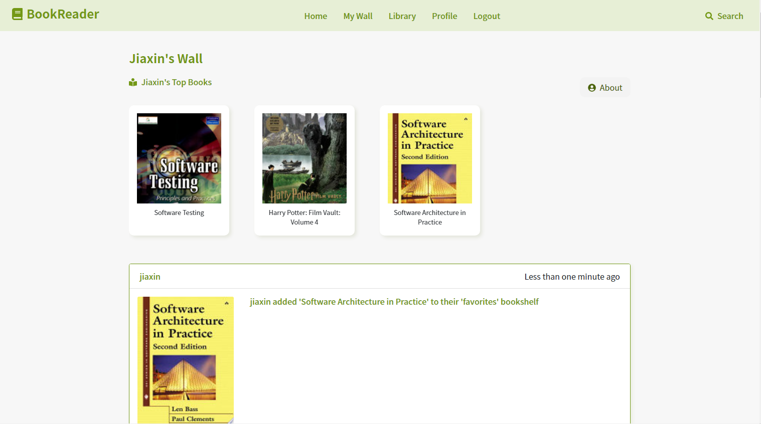
Fourth Functionality – Your Top Books
Notes:
Next, I’m going to introduce another functionality that we implemented, which is the top books of yours on private wall. So at this point, you may think about, what’s the difference between top books and favorite books?
The biggest difference is that, top books are those books that you want to recommend to all people who visit your private wall and favorite books are books that you like a lot but not necessarily need to share with others.
In our bookreader app, when the user goes into other user’s private walls or just go to their own wall, the bookreader app will display the top books that this person recommend. The user is able to edit their top books in the privacy setting pages.
This is the refresher of what this functionality looks like. I’ll then introduce the implementation of this functionality.

Slide 29
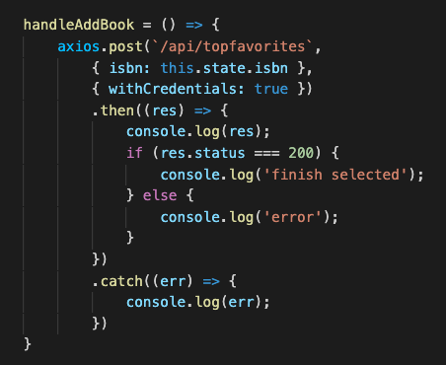
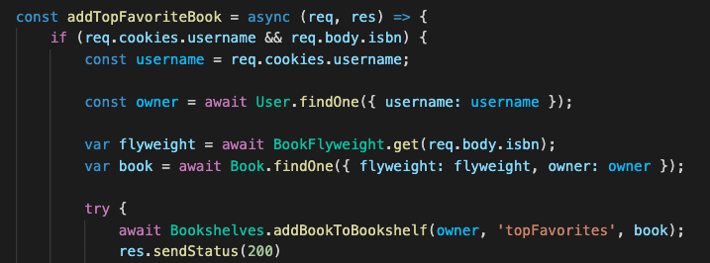
Edit your top books
Frontend
simpleBook.js
Backend
bookshelfController.js
Notes:
For the code snippet on the top, we can see that the frontend will fetch topbooks api to post the top books to our database in the backend. We implemented this functionality based on the bookshelf that we already have. We added another bookshelf called topbooks in our bookshelf schema then added our top books to the bookshelf. There is getTopBooks functions in the bookshelfControlller that you can find the books based on the logged in user.

Slide 30
Lessons Learned

Slide 31
Architectural Design
Modeling our architecture with 4 + 1 View Help us describe our software architecture with multiple views
Haiku Documentation Help us following our essential contextual information about a design decision
Notes:
At the end, I am gonna to show what we have learned in this class. First, we learned how to design our architecture. Modeling our architecture with view, helps us ……… to have a better understanding of our project. Writing a haiku document helps us following or improving our design decisions we made before.

Slide 32
Design Pattern
Follow the SOLID Principles
When to use appropriate design pattern without too much complexity
How to implement design patterns
Notes:
Also, We learned several design patterns. Creational, structural, behavioral following the solid principles. For example, most of functions are Single responsibility which helps us having a low coupling and high cohesion code. (Then we will not meet architectural violation problem). When we adding or refactoring our design pattern, we can easily update and did not violate our architecture. Next, we learn how to use design pattern appropriately. In our implementation, we strived to make sure that most of our design patterns remained relevant or necessary. Nevertheless, as we continued to develop, we realized that the incorporation of some design patterns will be too much for a simple functionality. For example, we did not need to use the singleton design pattern for our controllers. When we use unnecessary design patterns, our code will be more complex and less understandable, which can cause some problems and waste our development time.
Last, the most important one is that we learned how to implement design patterns in our projects as we show before.

Slide 33


New Technology
Notes:
Expected those we leaned in the lecture. We also learned a new framework -- React (framework). Some of us did not have experience with this, so we spent some time on the tutorial before we started our project. Overall, we worked very well with react. It saves us time on writing the frontend and has a beautiful UI.

Slide 34

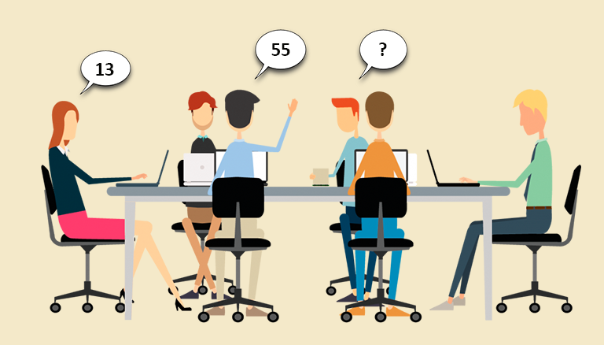
Workflow Management
Notes:
We learned how to design our workflow on our own. First, we design our backlog tasks by the order of priority. Then, we estimate with playing the planning poker and separate tasks to everyone equally. Each week, we have one meeting to stand up for what we have done so far and another optional meeting if we have any problems. Such workflow helps us having good time management to finish a solid application. Then, we did not have a big bang workload at the end.

Slide 35
Thank you!

